Slide 1
SESAR2020 PJ19.04.02 Environment Community of Practice -- Open-ALAQS
SESAR2020 Performance Framework Familiarization Session
26 May 2020

Slide 2

PJ19 – COMMUNAUTY OF PRACTICE

Slide 3

TRAINING + COACHING
Guidance + Awareness through WebExes
only when using EUROCONTROL’s applications, IMPACT and Open-ALAQS:
Support/Coaching Regular face-to-face trainings available through IANS catalogue of trainings
Ad-Hoc face-to-face trainings can be organised

Slide 4
NEXT WEBINARS – MAY 2020
19 May – 10:00 to 12:00 CET
Basic notions of environmental impact assessments
26 May – 10:00 to 12:00 CET
Noise and emissions assessments with IMPACT
26 May – 14:00 to 16:00 CET
Local air quality assessments with Open-ALAQS
Register from STELLAR

Slide 5
Introduction
Air pollution is one of the leading environmental causes of premature death in the EU
Estimates of the health impacts attributable to exposure to air pollution indicate that PM_{2.5} concentrations in 2016 were responsible for about 412 000 premature deaths originating from long-term exposure in Europe (over 41 countries), of which around 374 000 were in the EU-28.
The estimated impacts of exposure to NO₂ and O₃ concentrations on the population in these 41 European countries in 2016 were around 71 000 and 15 100 premature deaths per year, respectively, and in the EU‐28 around 68 000 and 14 000 premature deaths per year, respectively.
(Source: EEA Air quality in Europe — 2019 report)

Slide 6
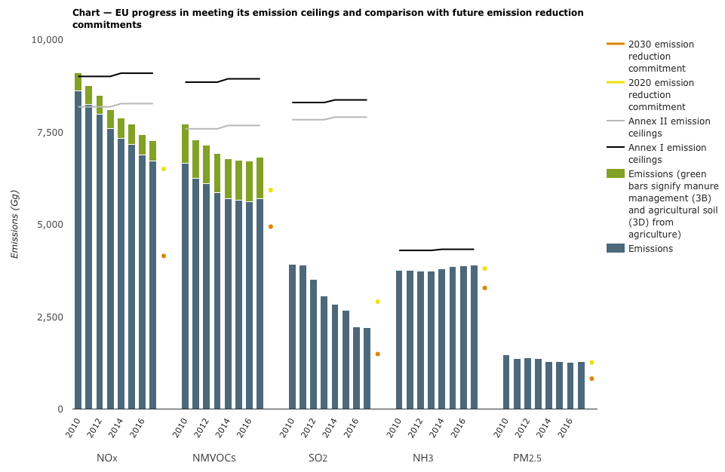
The EU long-term AQ objectives
Notes:
Looking ahead to 2030, further efforts are clearly required by Member States in order for them to meet their 2030 emission reduction commitments.

Slide 7
Relative importance of aviation emissions
Aircraft and all associated airport activities are sources of an assortment of gaseous and particulate emissions.
Nitrogen oxides (NOx), volatile organic compounds (VOCs), carbon monoxide (CO) and particulate matter (PM) are the most important contributors to LAQ concerns.
Notes:
By 2040, CO2 and NOX emissions are predicted to increase by at least 21% and 16% respectively.
The number of major airports that handle more than 50,000 annual aircraft movements is expected to increase from 82 in 2017 to 110 in 2040, and therefore aviation noise may well a ect new populations.
Aviation activities emit air pollutants not only during taxiing, take-off and landing, and cruising at altitude but also from the numerous ground support services, such as airport heating, and transport to and from airports.

Slide 8
Relative importance of aviation emissions
Aviation is not the only, and quite often not even the major contributor to local air pollution.
Airports are surrounded by other emission sources such as road networks and other industrial facilities that are known to contribute significantly to the degradation of local air-quality.
However, given the proximity of airports from urban centres and Europe’s population density emissions from aircraft and other emission sources at major European airports may have an effect on local air-quality.
Notes:
Aviation activities emit air pollutants not only during taxiing, take-off and landing, and cruising at altitude but also from the numerous ground support services, such as airport heating, and transport to and from airports.

Slide 9
Relative importance of aviation emissions
(ICAO Env. Report 2016)
Notes:
Schematic presentation of emissions, dispension, concentrations and impacts with their interaction at airport level.

Slide 10
Relative importance of aviation emissions
The sector’s high growth rate may be another aggravating factor:
The number of flights increased by 8% between 2014 and 2017, and grows by 42% from 2017 to 2040 in the most-likely forecast.
In 2016, aviation was accountable for 3.6% of the total EU28 greenhouse gas emissions and for 13.4% of the emissions from transport.
The number of major airports that handle more than 50,000 annual aircraft movements is expected to increase from 82 in 2017 to 110 in 2040, and therefore aviation noise may well a ect new populations.
By 2040, CO2 and NOX emissions are predicted to increase by at least 21% and 16% respectively.
(Source: EAER 2019)
Notes:
By 2040, CO2 and NOX emissions are predicted to increase by at least 21% and 16% respectively.

Slide 11
How to deal with the issue
The pragmatic solution to quantifying the relative contribution of an airport to air pollution levels and developing efficient emission reduction plans is through a combination of measurements and modelling.
Can also be used for forecasting future air-quality (changes in infrastructure and/or traffic and action planning
Notes:
Airports usually monitor air-quality at a daily or even hourly basis (it’s even legally required in several countries).
However, air-quality monitoring equipment records total concentration levels at specific points. Since airport-related activities are not the only source of emissions, measurements can be hard to interpret.
How can one be sure that the pollution recorded in the vicinity of an airport is really due to airport sources?
Due to the complex relationship between emissions and air-quality levels, measurements do not always provide sufficient insight for developing and implementing effective policies to reduce air pollution.
In addition, due to the complex relationship between emissions and air-quality levels, emission reduction plans do not always translate to a decrease in atmospheric concentrations for some pollutants (PM is a good example).
It can also be used for filling the gaps between measurements, allowing air-quality to be assessed at all locations of interest.
Moreover, it enables forecasting future air-quality to consider infrastructure projects or changes in or around the airport (aircraft and roadway traffic) and supports action planning by helping to understand whether proposed measures are likely to be effective and cost-effective in improving air-quality.

Slide 12
State of the art in ALAQ assessments
Current level of understanding in emissions inventories
(ICAO Env. Report 2016)

Slide 13
How we can improve our assessments
An “open” solution (or the “open-source approach”)
Lessons, values and principles from the open-source software community apply to the world beyond software development.
Problem-solving as a collective effort.
Useful ideas can rise from people outside an organization’s own roster of employees.
Need for a common platform that will enable all interested parties to gravitate towards this new solution.
Benefits include constant improvement and higher quality of results (increased auditability), customizability, flexibility and lower cost.
Notes:
By embracing this approach, airports can move beyond the old paradigm -in which each airport solves issues individually- and start thinking about problem-solving as a collective effort. This concept rests on the recognition that useful ideas can rise from people outside an organization’s own roster of employees.
What is needed to initiate such activity is a common platformthat will enable airports to gravitate towards this new solution.

Slide 14
Open-ALAQS: General context
The first version of ALAQS was developed by the EUROCONTROL Experimental Centre between 2002 and 2009 under the name ALAQS-AV
ALAQS-AV was approved for use by the ICAO Committee on Aviation Environmental Protection (cf. CAEP/9-IP/13, Dec. 2009)
Open-ALAQS was developed in the context of the SESAR Programme to allow SESAR partners to perform local air quality assessments
https://www.eurocontrol.int/online-tool/airport-local-air-quality-studies

Slide 15
Open-ALAQS architecture
Completely built around an open architecture
Modular design
Works with QGIS
Coupled with AUSTAL
Notes:
Open ALAQS was designed to be entirely modular in the sense that we use dedicated modules for each ..
Therefore, there is a clear separation of concerns from UI to calculation methods for emissions to datasets used
Every source sources or calculation method can be easily updated or replaced

Slide 16
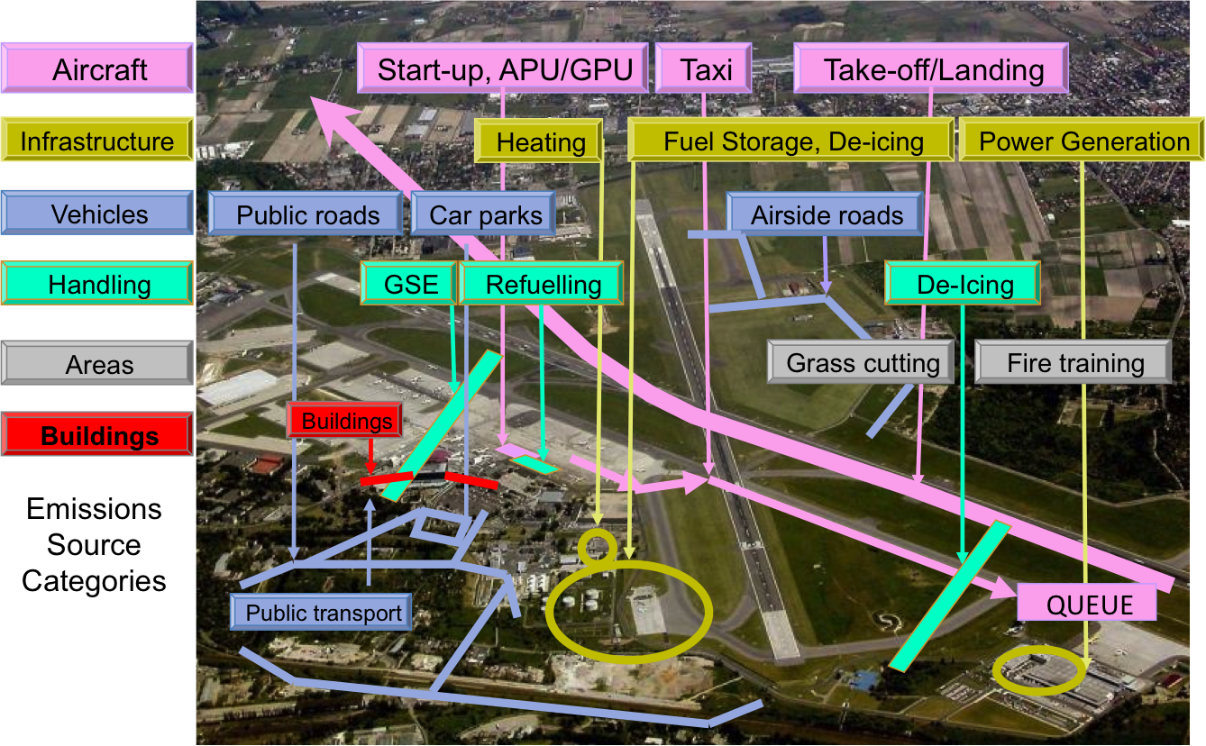
Emissions sources in Open-ALAQS
Notes:
Source types:
Non-Aircraft: Area sources, Parking lots, Roadways and Point sources
Aircraft-related: Gates, Runways, Taxiways and Tracks

Slide 17
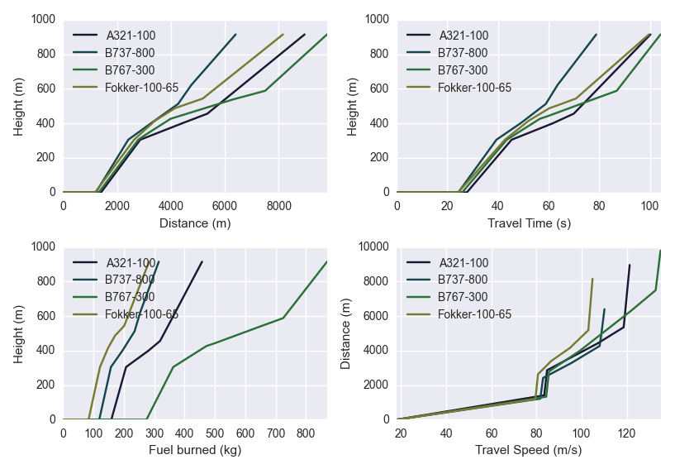
Emission factors & Performance profiles
ICAO Engine Emissions Databank for aircraft jet engine emission factors (EFs)
FOCA Piston Engine EFs
Possible to use turboprops EFs from the confidential FOI data base
Performance profiles:
Aircraft Noise and Performance Database
Road Traffic:
Adapted from the COPERT IV method
and emission factors
Notes:
Regarding the datasets used in ALAQS for calculating emissions
Emissions of SO_{X} have been implemented according to the U.S. EPA recommendation for commercial aviation jet fuel
PM10 emissions from FOA3

Slide 18
Functionalities (I)
Taxiing emissions (incl. APU/GPU/GSE emissions):
Idle mode (default) or ARR/DEP queuing
More suitable for SESAR concepts validation (i.e. considering stop & go’s and its impact on engine thrust in the calculations)
Taxi-routes and Main-Engine Start (MES):
For outbound Taxi-route a MES Taxiway can be designated
Custom or default engine thrust level for taxiing
EF from engine rated output (or else default EF)
Operational towing
For departure movements between the Stand and the MES Taxiway
Engine-out Taxiing (EOT)
Notes:
MES emissions can occur at the stand and/or at a designated location on the taxi route
MES emission factors are now derived from the engine rated output where the rated is known otherwise default emission factors for the Aircraft Group are used.
APU emissions as a function of Location, Movement, APU Code, APU Mode

Slide 19
Functionalities (II)
Emissions Calculation:
By Mode (AP, TO, CL, TX)
BFFM2 / Fuel Flow method:
Adjusted indices for NOx, CO and HC for reduced thrust, ambient conditions and speed
NOx corrections for ambient conditions:
Correction for AC weight, ambient temperature & humidity (cf. ICCAIA)
Customisable activity profiles (hourly, daily & monthly)
Possible to configure individual engines for each movement (by engine UID)
Flexibility in the selection of sources type & name, pollutant

Slide 20

Dispersion modelling
The official reference model of the German Regulation on Air Quality Control (Technische Anleitung zur Reinhaltung der Luft, TA Luft)
Lagrangian particle model in conformance with the German guideline VDI 3945 Part 3.
It accounts for several different pollutants, each with specific results, which are strictly bound to the regulations of the German Standard TA Luft 2002 (acc. to European EC Directive 2008/50/EC)
AUSTAL2000 is provided free of charge under the GNU Public Licence
More info: http://www.austal2000.de/en/home.html
Notes:
AUSTAL2000 is constantly maintained by the German Federal Agency. The German Federal Agency agreed to allow EUROCONTROL to include 3-dimensional emission grids into the official model AUSTAL2000 version (preliminary version 2.7). Consequently, Open-ALAQS will benefit from any official version updates in the future. The new AUSTAL2000 version will be made publicly available once additional extensions in connection with the current update of TA Luft are finalized (probably towards end of 2016).

Slide 21
Configuration of Open-ALAQS / AUSTAL
Coupling based on the existing architecture of Open-ALAQS
Open-ALAQS remains independent of the dispersion model and other similar modules can be added in the future.
AUSTAL2000 module: All necessary parameters (time-dependent or not) and input files prepared from Open-ALAQS
The AUSTAL2000 module can be enabled or disabled
MET data:
possible to convert files with meteorological time series, as provided by local or national data providers (e.g. METAR, SYNOP) into input data
All MET parameters are given default values
Notes:
All the necessary parameters (time-dependent or not) and input files are prepared from within Open-ALAQS.
All necessary parameters have been given default values, which can be modified by the user.
The whole AUSTAL2000 module can be enabled or disabled. Therefore, the emissions’ calculation with Open-ALAQS can be performed independently.

Slide 22
Thank you very much for your attention!
open-alaqs@eurocontrol.int

Slide 23
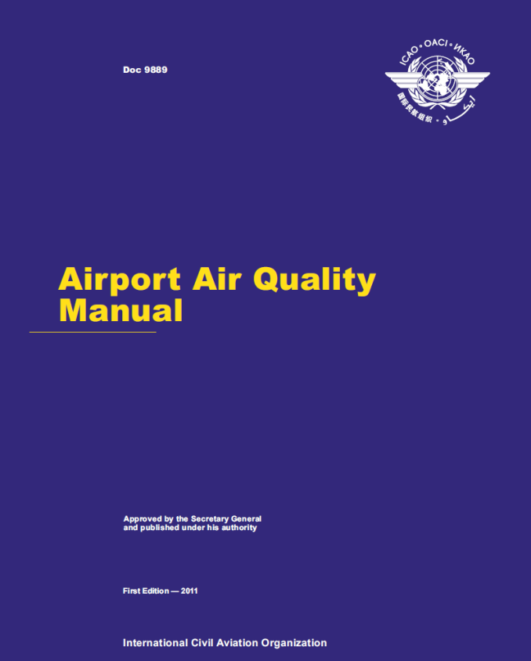
GUIDANCE DOCUMENTS 1/2
ICAO Doc 9889

